Slide 1

Search Engine Working

Slide 2
Search Engine Working
Ranking
What is rank? A position in a hierarchy or scale.
Searching anything on web using search engine will be a hectic task without the use of proper ranking technique.
It is very important for any search engine to use algorithm to rank the searched pages according to the requirement of user.
Because just simply giving the search result will not much pleased to the user as compared to better ranked data.

Slide 3
Search Engine Working
TYPES OF RANKING ALGORITHMS
Text-based ranking algorithm: The ranking scheme used in the conventional search engines is purely Text-Based i.e. the pages are ranked based on their textual content and number of matched terms with the query string. , which seems to be logical.
HITS (Hyperlink Induced Topic Search)
SALSA: The Stochastic Approach for Link- Structure Analysis. Probabilistic extension of the HITS algorithm.
PageRank algorithm
1st rank…..2nd rank……3rd rank……10th rank………….

Slide 4
Search Engine Working
TYPES OF RANKING ALGORITHMS
Weighted Page Rank algorithm: Weighted Page Rank algorithm is an extension of the Page-Rank algorithm. This algorithm allocates a higher rank values to the more significant pages rather than dividing the rank value of a page evenly among its outgoing linked web pages.
Distance Rank Algorithm: The distance between pages is considered as a factor. The algorithm calculates the minimum average distance between two or more web pages.
Topic sensitive Rank Algorithm : This algorithm computes the scores of web page according to the importance of content available on web page.

Slide 5
Search Engine Working
PAGERANK ALGORITHM
In “PageRank” the page word is not for web page though it is used for ranking pages.
The PageRank algorithm originally developed at Stanford University by Larry Page in 1996 as part of a research project about a new search engine. So it got its name from Larry Page.
PageRank is an algorithm used by the Google web search engine to rank websites in their search engine results.
The PageRank algorithm does not rank the whole website, but it’s determined for each page individually.

Slide 6
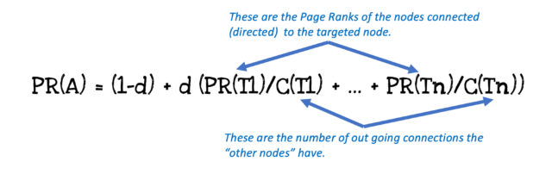
PR Formula
d = Damping Factor ; PR(N) = PR of Linking Site ; T(N) : No of Outbound Links

Slide 7
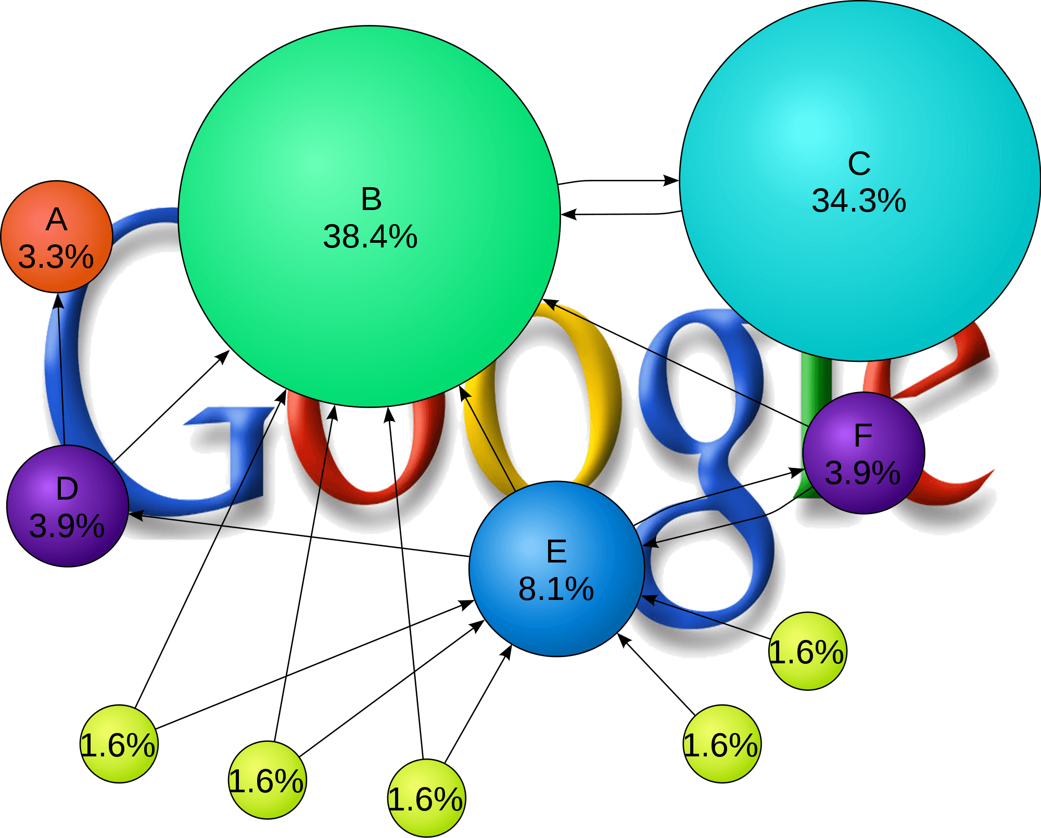
Example
you can use the original formula for calculating PageRank:
PR(A) = (1-d) + d (PR(T1)/C(T1) + … + PR(Tn)/C(Tn))
https://www.sycosure.com/blog/google-pagerank-check/

Slide 8
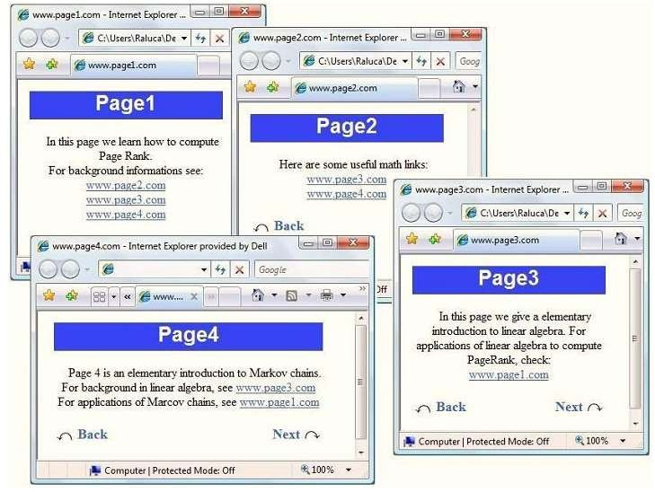
Now lets take a look at how it works:
http://www.math.cornell.edu/~mec/Winter2009/R

Slide 9
STEP: 1
STEP: 2
A
B
C
PR(A)=(1-d)+d(PR(T1)/C(T1)+………+ PR(Tn)/C(Tn))

Slide 10
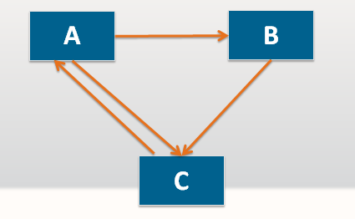
Initial Page Rank (PR) for all web pages =1
PR(A)=(1-d)+d(PR(T1)/C(T1)+………+ PR(Tn)/C(Tn))
Iteration 1
PR(A)=(1-d)+d(PR(C)/C(C)
=(1-0.85)+0.85(1/1)
=0.15+0.85
=1
PR(B)=(1-d)+d(PR(A)/C(A)
=(1-.85)+0.85(1/2)
=0.15+0.85*0.5
=0.15+0.425
=0.575
PR(C)=(1-d)+d[(PR(A)/C(A)+ (PR(B)/C(B)]
=0.15+0.85[(1/2)+ (0.575/1)]
=0.15+0.85(0.5+0.575)
=1.13875
PR(C)
C(C)

Slide 11
Initial Page Rank (PR) for all web pages =1
PR(A)=(1-d)+d(PR(T1)/C(T1)+………+ PR(Tn)/C(Tn))
Iteration 2
PR(A)=(1-d)+d(PR(C)/C(C)
=(1-0.85)+0.85(1.06375/1)
=0.15+0.9041875
=1.0541875
PR(C)
PR(B)=(1-d)+d(PR(A)/C(A)
=(1-.85)+0.85(1.0541875/2)
=0.15+0.85*0.52709375
=0.15+0.4480296875
=0.5980296875
PR(C)=(1-d)+d[(PR(A)/C(A)+(PR(B)/C(B)]
=0.15+0.85[(1.0541875/2)+ (0.59802/1)]
=1.063547
C(C)

Slide 12
Initial Page Rank (PR) for all web pages =1
PR(A)=(1-d)+d(PR(T1)/C(T1)+………+ PR(Tn)/C(Tn))
Iteration | A | B | C
0 | 1 | 1 | 1
1 | 1 | 0.575 | 1.13875
2 | 1.0541875 | 0.5980296875 | 1.063547
PR(C)
C(C)

